Slide 1
Stack And Queue

Slide 2
Stack Data Structure
A stack is a linear data structure that follows the Last-In-First-Out (LIFO) principle.
E.g. It behaves like a stack of plates, where the last plate added is the first one to be removed.
Think of it this way:
Pushing an element onto the stack is like adding a new plate on top.
Popping an element removes the top plate from the stack.

Slide 3
Key Operations on Stack Data Structures
Push: Adds an element to the top of the stack.
Pop: Removes the top element from the stack.
Peek: Returns the top element without removing it.
IsEmpty: Checks if the stack is empty.
IsFull: Checks if the stack is full (in case of fixed-size arrays).

Slide 4
Applications of Stack Data Structures
Recursion
Expression Evaluation and Parsing
Depth-First Search (DFS)
Undo/Redo Operations
Browser History
Function Calls

Slide 5
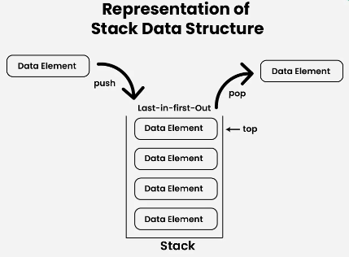
Types of Stack
Fixed Size Stack
Dynamic Size Stack

Slide 6
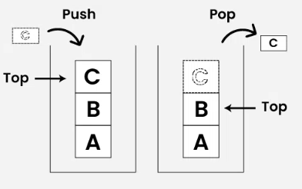
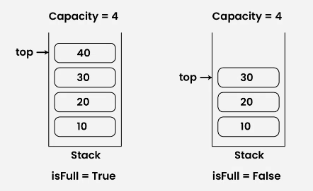
Operation
Push :To insert element at stack
Overflow condition.
Pop :Delete element from stack
Underflow condition.
Peek:
IsEmpty:
IsFull:

Slide 7
Disadvantages of Stack Data Structure:
Limited access: Elements in a stack can only be accessed from the top, making it difficult to retrieve or modify elements in the middle of the stack.
Potential for overflow: If more elements are pushed onto a stack than it can hold, an overflow error will occur, resulting in a loss of data.
Not suitable for random access: Stack s do not allow for random access to elements, making them unsuitable for applications where elements need to be accessed in a specific order.
Limited capacity: Stacks have a fixed capacity, which can be a limitation if the number of elements that need to be stored is unknown or highly variable.

Slide 8
Queue
A Queue Data Structure is a fundamental concept in computer science used for storing and managing data in a specific order.
It follows the principle of “First in, First out” (FIFO), where the first element added to the queue is the first one to be removed.

Slide 9
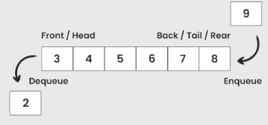

Slide 10
Basic Operations of Queue
Enqueue (Insert): Adds an element to the rear of the queue.
Dequeue (Delete): Removes and returns the element from the front of the queue.
Peek: Returns the element at the front of the queue without removing it.
Front: Returns the element at the front of the queue without removing it.
Rear: Returns the element at the rear of the queue without removing it.
Empty: Checks if the queue is empty.
Full: Checks if the queue is full.

Slide 11
Applications
Task scheduling in operating systems
Data transfer in network communication
Simulation of real-world systems (e.g., waiting lines)
Priority queues for event processing queues for event processing

Slide 12
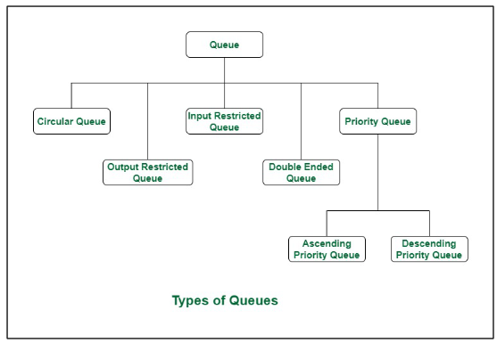
Types

Slide 13
Queue
Queue(int c)
{
front = 0;
rear = -1;
}
void Enqueue(int data) {
if (rear == n) {
print ("\nQueue is full\n");
}
rear++;
queue[rear] = data;
}
void Dequeue() {
int temp=0;
if (rear<0) {
print ("\nQueue is empty\n");
}
temp= queue[front]
for (int i = 0; i < rear; i++) {
queue[i] = queue[i + 1];
}
rear--;
return temp;
}

Slide 14
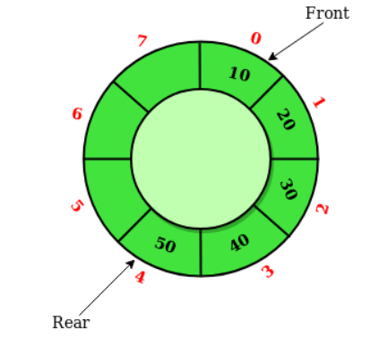
Circular Queue

Slide 15
Implementation
initialize two variables front and rear to -1.
Enqueue:
Increment rear by 1.
If rear is equal to n AND Front if equal to 0,
Message Queue is Full
Else set rear to 0.
If front is -1, set front to 0.
Set queue[rear] to INPUT DATA.
Dequeue:
If Front is -1, return an error message indicating that the queue is empty.
Set temp to queue[front].
If front is equal to rear, set front and rear to -1.
Otherwise, increment front by 1 and if front is equal to n, set front to 0.
Return temp.

